Slide 1
rattanavilay-Assignment-9.2-Exercises
File created on: 11/1/20 5:42:48 PM PST

Slide 2
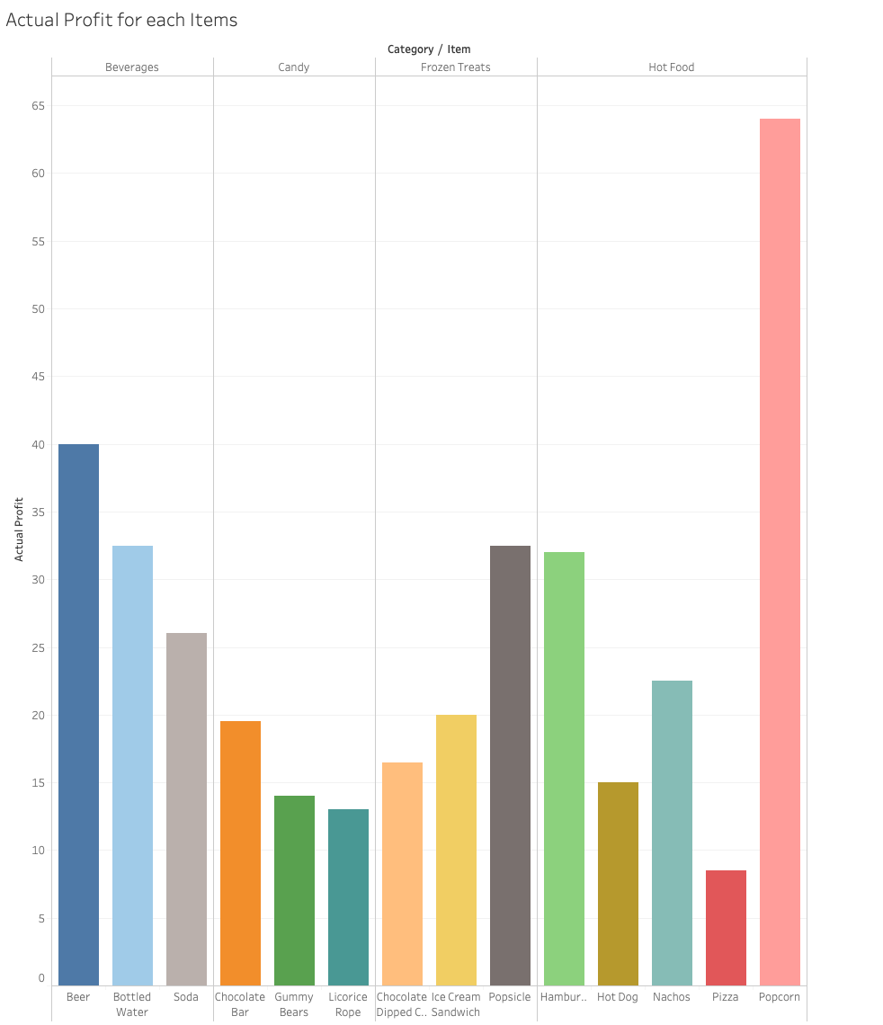
This chart shows the actual profit for each items sold here at the baseball game

Slide 3
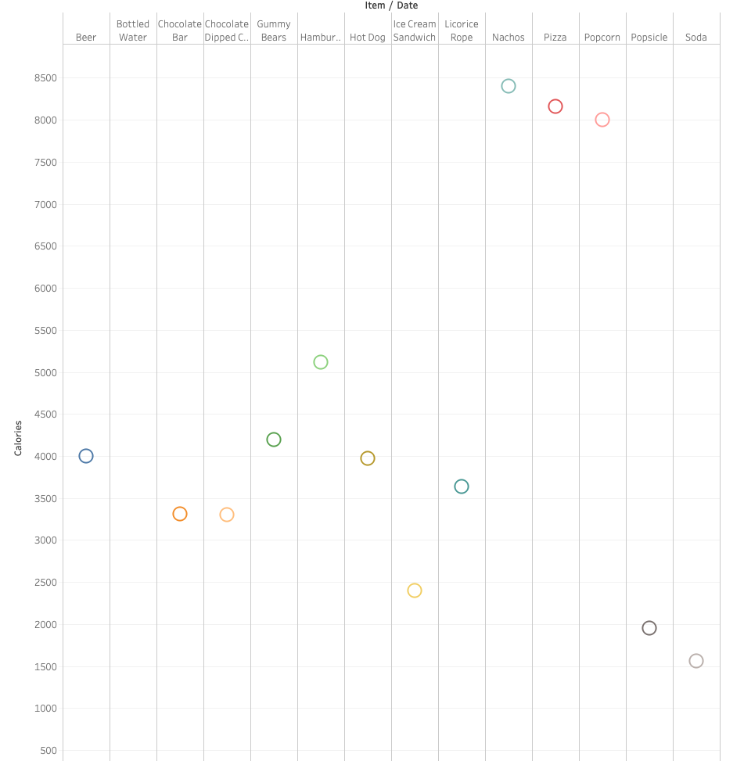
On this chart we have displayed the calories based on each items

Slide 4
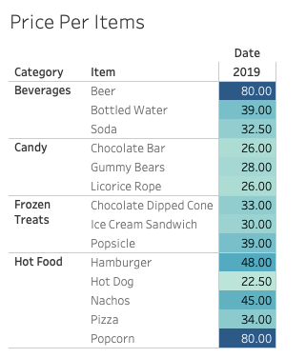
I created a price per item list which has the category and item show here

Slide 5
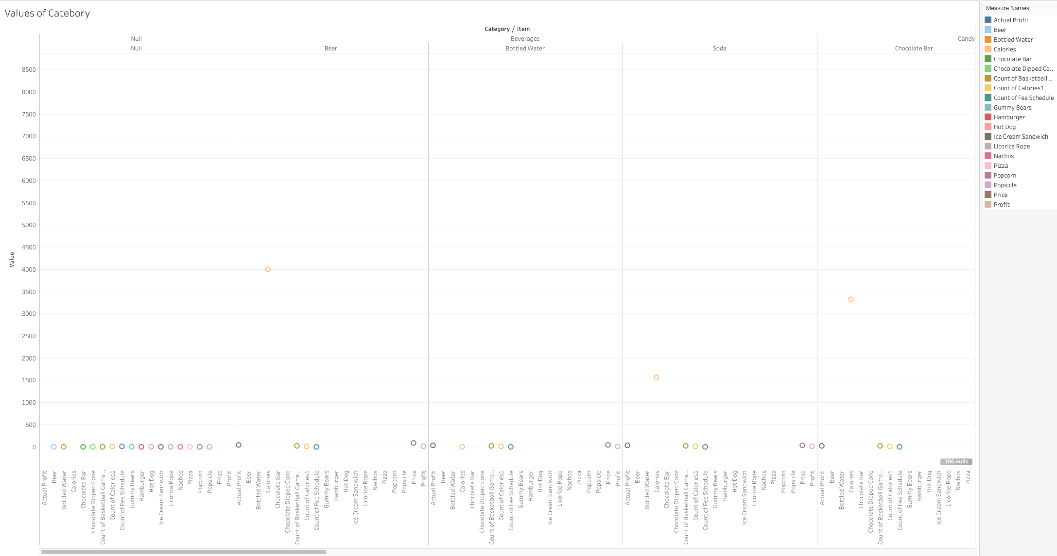
Here you’ll find the values of items based on the category and this list everything under the data sheet

Slide 6
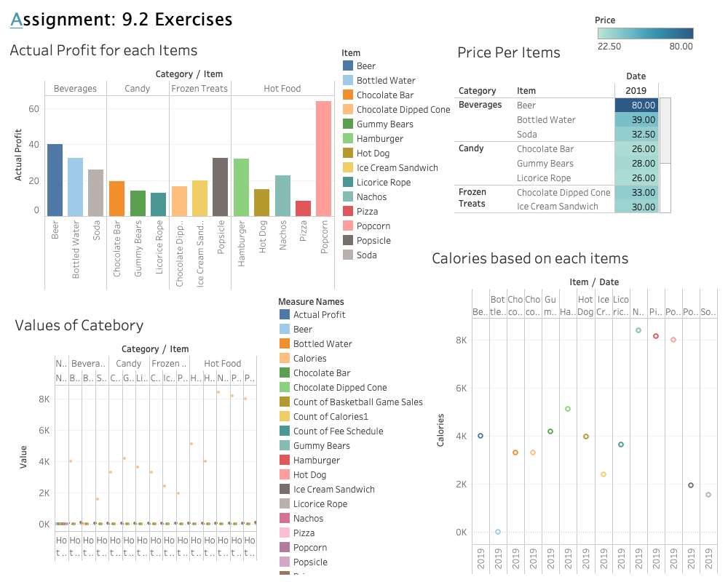
My Dashboard

